Slide 1
Operating Systems
Evolution of Operating Systems
A. Frank - P. Weisberg

Slide 2
Evolution of Operating Systems
Early Systems (1950)
Simple Batch Systems (1960)
Multiprogrammed Batch Systems (1970)
Time-Sharing and Real-Time Systems (1970)
Personal/Desktop Computers (1980)
Multiprocessor Systems (1980)
Networked/Distributed Systems (1980)
Web-based Systems (1990)
A. Frank - P. Weisberg

Slide 3
Time-Sharing
Batch multiprogramming does not support interaction with users.
Time-sharing extends Batch Multiprogramming to handle multiple interactive jobs –
it’s Interactive Multiprogramming.
Multiple users simultaneously access the system through commands entered at terminals.
Processor’s time is shared among multiple users.
A. Frank - P. Weisberg

Slide 4
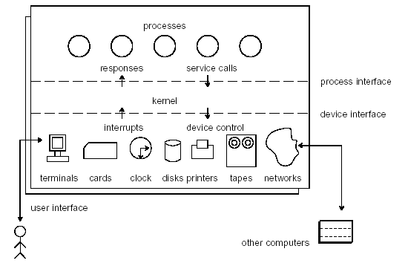
Time-sharing Architecture
A. Frank - P. Weisberg

Slide 5
Why Time-sharing?
In Time-sharing (multitasking) the CPU switches jobs so frequently that users can interact with each job while it is running, creating interactive computing:
  Response time should be < 1 second.
  Each user has at least one program (process) executing in memory.
  CPU scheduling supports several jobs ready to run at the same time.
  If processes don’t fit in memory, swapping moves them in and out to run.
  Virtual memory allows execution of processes not completely in memory.
A. Frank - P. Weisberg

Slide 6
Why did Time-Sharing work?
Because of slow human reaction time, a typical user needs 2 seconds of processing time per minute.
Then many users should be able to share the same system without noticeable delay in the computer reaction time.
The user should get a good response time.
It fit the economic basis of the mainframe computer installation.
A. Frank - P. Weisberg

Slide 7
Real-Time Systems
Note that not all Operating Systems are general-purpose systems.
Real-Time (RT) systems are dedicated systems that need to adhere to deadlines , i.e., time constraints.
Correctness of the computation depends not only on the logical result but also on the time
at which the results are produced.
A. Frank - P. Weisberg

Slide 8
Hard Real-Time Systems
Hard real-time system must meet its deadline.
Conflicts with time-sharing systems, not supported by general-purpose OSs.
Often used as a control device in a dedicated application:
  Industrial control
  Robotics
Secondary storage limited or absent, data/program is stored in short term memory,
or Read-Only Memory (ROM).
A. Frank - P. Weisberg

Slide 9
Soft Real-Time Systems
Soft real-time system:
  Deadlines desirable but not mandatory.
  Limited utility in industrial control or robotics.
  Useful in modern applications (multimedia, video conference, virtual reality) requiring advanced operating-system features.
A. Frank - P. Weisberg

Slide 10
Personal/Desktop Computers (1)
Personal computers – computer system dedicated to a single user.
I/O devices: keyboards, mice, display screens, small printers.
User convenience and responsiveness.
Can adopt technology developed for larger operating system; often individuals have sole use of computer and do not need advanced CPU utilization of protection features.
May run several different types of operating systems (Windows, MacOS, UNIX, Linux)
A. Frank - P. Weisberg

Slide 11
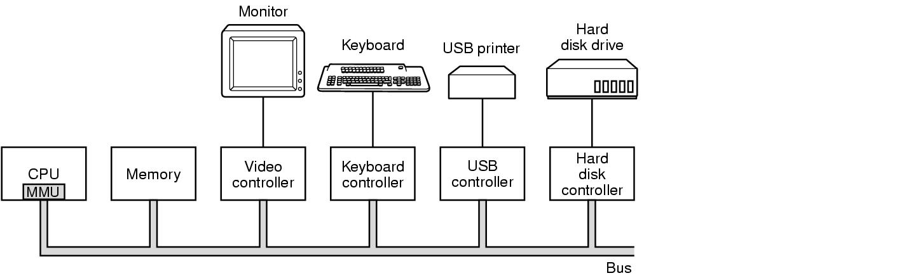
Components of a simple personal computer
A. Frank - P. Weisberg

Slide 12
(2) Personal/Desktop Systems
Traditional personal computer blurring over time.
Office environment:
  PCs connected to a network, terminals attached to mainframe or minicomputers providing batch and timesharing.
  Now portals allowing networked and remote systems access to same resources.
Home networks:
  Used to be single system, then modems
  Now firewalled, networked.
A. Frank - P. Weisberg

Slide 13
Two categories of Computer Systems
Single Instruction Single Data (SISD) –
  single processor executes a single instruction sequence to operate on data stored in a single memory.
  This is a Uniprocessor.
Multiple Instruction Multiple Data (MIMD) -
  a set of processors simultaneously execute different instruction sequences on different data sets.
  This is a Multiprocessor.
A. Frank - P. Weisberg

Slide 14
Multiprocessor Systems
System with several CPUs in close communication:
  processors share memory and a clock.
  communication usually takes place through the shared memory.
Also known as parallel systems, tightly-coupled systems.
Multiprocessors systems growing in use and importance – advantages include:
  Increased throughput
  Economy of scale
  Increased reliability – graceful degradation or fault tolerance.
A. Frank - P. Weisberg

Slide 15


Multiprocessor Architecture
A. Frank - P. Weisberg

Slide 16
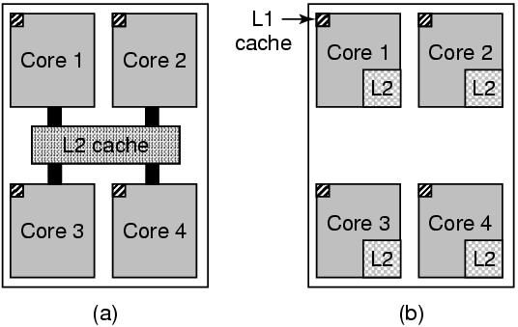
Multithreaded/Multicore Chips
A. Frank - P. Weisberg

Slide 17
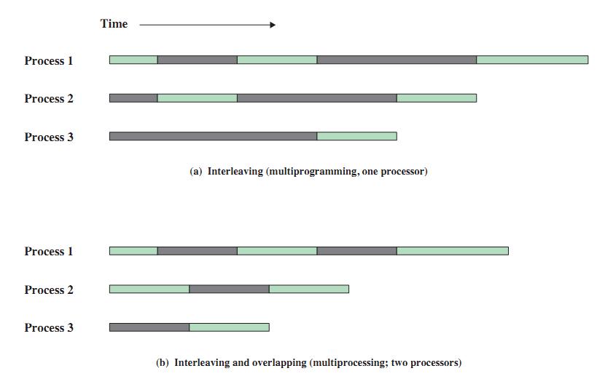
Multiprogramming vs. Multiprocessing
A. Frank - P. Weisberg

Slide 18
Types of Multiprocessor Systems
Asymmetric Multiprocessing
  master processor schedules and allocates specific work to slave processors.
Symmetric Multiprocessing (SMP)
  Each processor runs an identical copy of the OS.
  Typically each processor does self-scheduling form the pool of available processes.
  Most modern operating systems support SMP.
A. Frank - P. Weisberg

Slide 19
Symmetric Multiprocessing (SMP)
Each processor can perform the same functions and share same main memory and I/O facilities (symmetric).
The OS schedule processes/threads across all the processors (real parallelism).
Existence of multiple processors is transparent to the user.
Incremental growth: just add another CPU!
Robustness: a single CPU failure does not halt the system, only the performance is reduced.
A. Frank - P. Weisberg

Slide 20
Clustered Systems (1)
Like multiprocessor systems, but multiple systems working together.
Also known as closely-coupled system.
Clustering allows two or more systems to share external storage and balance CPU load:
  processors also have their own external memory.
  communication takes place through high-speed channels.
  Provides high-availability
A. Frank - P. Weisberg

Slide 21
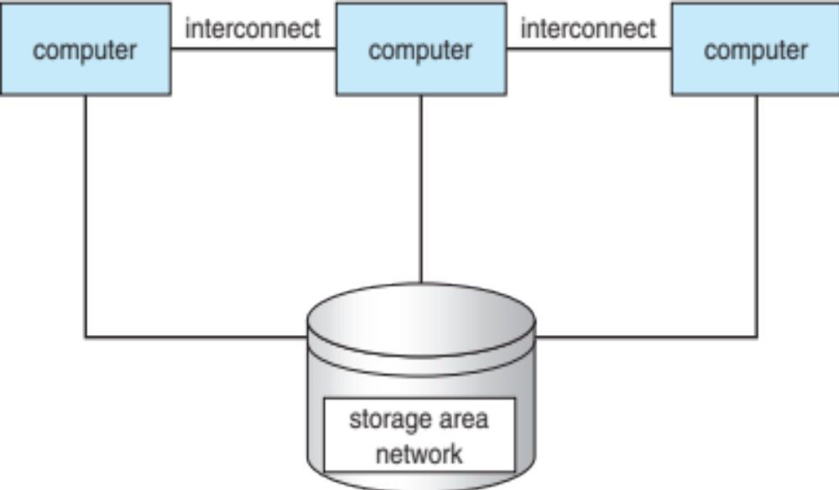
Clustered Systems Architecture
A. Frank - P. Weisberg

Slide 22
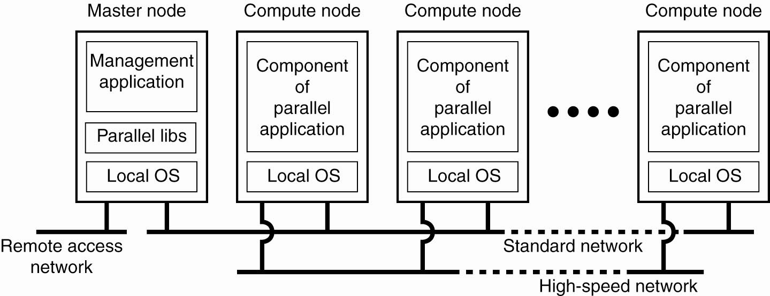
Architecture for Cluster Computing System

Slide 23
Clustered Systems (2)
Usually sharing storage via a Storage-Area Network (SAN).
Provides a high-availability service which survives failures:
  Asymmetric clustering has one machine in hot-standby mode
  Symmetric clustering has multiple nodes running applications, monitoring each other.
Some clusters are used for high-performance computing (HPC) where applications must be written to use parallelization.
A. Frank - P. Weisberg

Slide 24
Networked Systems
Distribute resources and the computation among several physical processors.
Loosely coupled system:
  each processor has its own local memory.
  processors communicate with one another through various communications lines.
Advantages:
  Resources Sharing
  Computation speed up – load sharing
  Reliability
A. Frank - P. Weisberg

Slide 25
Networked System Structure
node 2
node 1
disk
disk
processors
processors
disk
disk
network
node 3
node N
disk
disk
processors
processors
disk
…
disk
A. Frank - P. Weisberg

Slide 26
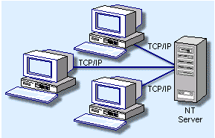
Networked Systems
Requires networking infrastructure.
Most are Local area networks (LAN) or Wide area networks (WAN).
May be either Centralized Sever or Client/Server or Peer-to-Peer (P2P) systems.
A. Frank - P. Weisberg

Slide 27
Local Area Network (LAN)
LAN designed to cover small geographical area:
  Multiaccess bus, ring, or star network.
  Speed ≈ 10–100 Megabits/second.
  Broadcast is fast and cheap.
  Nodes:
    usually workstations and/or personal computers.
    a few (usually one or two) mainframes.

Slide 28
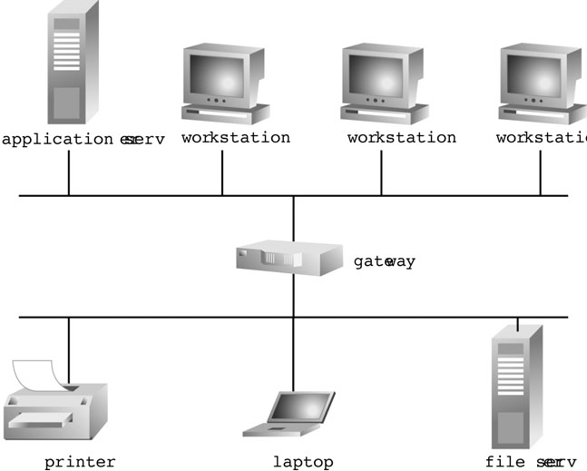
Example of Local Area Network (LAN)
A. Frank - P. Weisberg

Slide 29
Wide-Area Network (WAN)
Links geographically separated sites:
  Point-to-point connections over long-haul lines (often leased from a phone company).
  Speed ≈ 1.544–45 Megabits/second.
  Broadcast usually requires multiple messages.
  Nodes:
    usually a high percentage of mainframes.

Slide 30
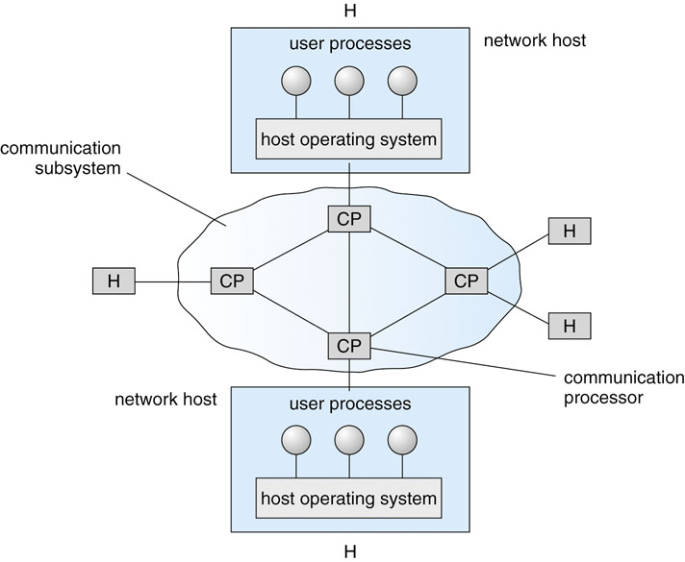
Example of Wide Area Network (WAN)
A. Frank - P. Weisberg

Slide 31
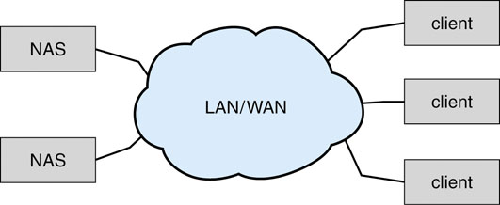
Network-attached Storage (NAS)
A. Frank - P. Weisberg

Slide 32
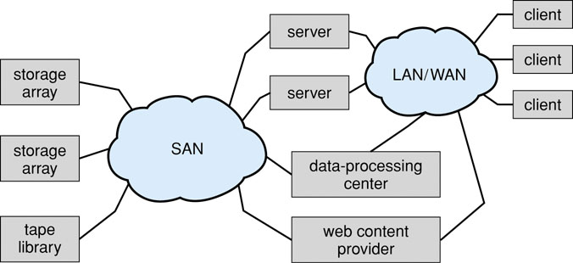
Storage-area Network (SAN)
A. Frank - P. Weisberg

Slide 33
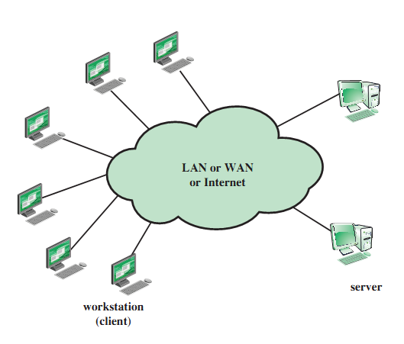
Generic Client/Server Environment
A. Frank - P. Weisberg

Slide 34
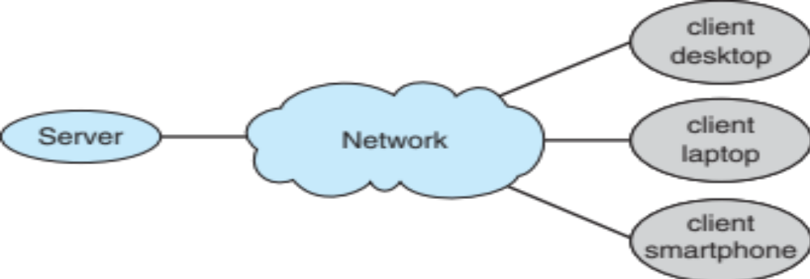
Client/Server Computing
Dumb terminals supplanted by smart PCs.
Many systems are now servers, responding to requests generated by clients:
  Compute-server provides an interface
  to client to request services (i.e., database).
  File-server provides interface for clients to store and retrieve files.
A. Frank - P. Weisberg

Slide 35
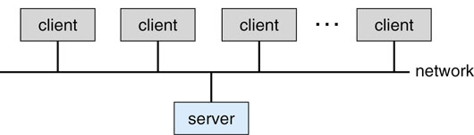
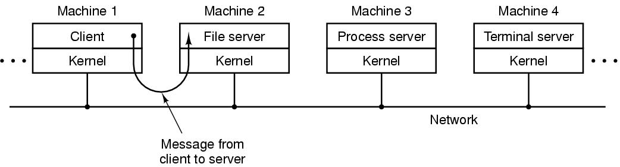
General Structure of a Client/Server System
A. Frank - P. Weisberg

Slide 36
Distributed Systems
Distributed system is collection of loosely coupled processors interconnected by a communications network.
Processors variously called nodes, computers, machines, hosts.
Reasons for distributed systems:
  Resource sharing:
    sharing and printing files at remote sites.
    processing information in a distributed database.
    using remote specialized hardware devices.
  Computation speedup – load sharing.
  Reliability – detect and recover from site failure, function transfer, reintegrate failed site.
  Communication – message passing.

Slide 37
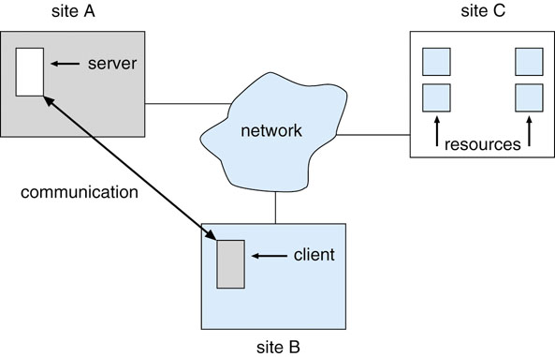
Distributed Systems
A. Frank - P. Weisberg

Slide 38
Peer-To-Peer (P2P)
P2P does not distinguish clients and servers.
Instead all nodes are considered peers.
May each act as client, server or both.
Node must join P2P network:
  Registers its service with central lookup service on network, or
  Broadcasts request for service and responds to requests for service via discovery protocol.
  Examples include Napster and Gnutella, Voice over IP (VoIP) such as Skype.
.
A. Frank - P. Weisberg

Slide 39
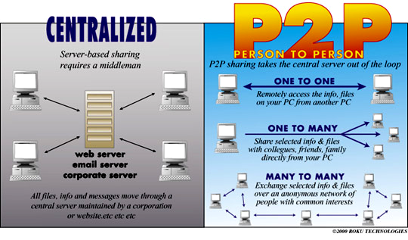
Peer-To-Peer (P2P) Systems
DISTRIBUTED SERVICE
A. Frank - P. Weisberg

Slide 40
(NOS) Networked Operating Systems
Each computer runs independently from other computers on the network.
Provides mainly file sharing.
Users are aware of multiplicity of machines.
Access to resources of various machines is done explicitly by:
  Remote logging into the appropriate remote machine
  (telnet, ssh).
  Remote Desktop (Microsoft Windows).
  Transferring data from remote machines to local machines, via the File Transfer Protocol (FTP) mechanism.
A. Frank - P. Weisberg

Slide 41
Distributed Operating Systems (DOS)
Gives the impression there is a single operating system controlling the network.
Users not aware of multiplicity of machines
  Access to remote resources similar to access to local ones.
Network is mostly transparent – it’s a powerful virtual machine.
Data Migration – transfer data by transferring entire file, or transferring only those portions of the file necessary for the immediate task.
Computation Migration – transfer the computation, rather than the data, across the system.
Process Migration – execute an entire process, or parts of it, at different sites.
A. Frank - P. Weisberg

Slide 42
Web-based Systems
Web has become ubiquitous.
PCs most prevalent devices.
More devices becoming networked to allow web access.
New category of devices to manage
Web traffic among similar servers:
Load Balancers.
Basis for Grids/Cloud Computing.
A. Frank - P. Weisberg

Slide 43
Grid Computing Systems
Collection of computer resources, usually owned by multiple parties and in multiple locations, connected together such that users can share access to their combined power:
  Can easily span a wide-area network
  Heterogeneous environment
  Crosses administrative/geographic boundaries
  Supports Virtual Organizations (VOs)
Examples: EGEE - Enabling Grids for E-SciencE (Europe), Open Science Grid (USA).

Slide 44
Cloud Computing Systems (1)
Collection of computer resources, usually owned by a single entity, connected together such that users can lease access to a share of their combined power:
  Location independence: the user can access the desired service from anywhere in the world, using any device with any (supported) system.
  Cost-effectiveness: the whole infrastructure is owned by the provider and requires no capital outlay by the user.
  Reliability: enhanced by way of multiple redundant sites, though outages can occur, leaving users unable to remedy the situation.

Slide 45
Cloud Computing Systems (2)
  Scalability: user needs can be tailored to available resources as demand dictates – cost benefit is obvious.
  Security: low risk of data loss thanks to centralization, though problems with control over sensitive data need to be solved.
  Readily consumable: the user usually does not
  need to do much deployment or customization,
  as the provided services are easy to adopt and ready-to-use.
Examples: Amazon EC2 (Elastic Compute Cloud), Google App Engine, IBM Enterprise Data Center,
MS Windows Azure, SUN Cloud Computing.

Slide 46
Handheld Systems
Handheld systems are also dedicated:
  Personal Digital Assistants (PDAs).
  Cellular telephones.
Issues:
  Limited memory
  Slow processors
  Small display screens
  Support for multimedia (images, video).
A. Frank - P. Weisberg

Slide 47
Mobile Systems
Handheld smartphones, tablets, etc.
What is the functional difference between them and a “traditional” laptop?
Extra feature – more OS features (GPS, gyroscope).
Use IEEE 802.11 wireless, or cellular data networks for connectivity.
Allows new types of apps like augmented reality.
Leaders are Apple iOS and Google Android.
A. Frank - P. Weisberg

Slide 48

Migration of OS Concepts and Features
A. Frank - P. Weisberg

